Slide 1
Website Development Different Users
Neil Buckley
FML308B
bucklen@hope.ac.uk

Slide 2
Assessment Criteria
Ace training requires a new system for students that enrol onto their course(s). There will typically be three methods of enrolment: from a list, by a tutor, or by a student. Students that register themselves require authorising by the tutor. Tutors are created by administrator(s) after the credentials of the tutor has been checked. To become a course tutor the individual will register as a tutor.
The tutor will have the facility of uploading various resources, such as powerpoint presentations and documents. Once uploaded they should either: be made available to the student, not available or available within a specified date range.
Satisfactory

Slide 3
Actions
Add Course
Add Student
Add Tutor
Student enrol Course
Tutor Authorise Student

Slide 4
What we have done
Database
Created a database
Table (user)
Fields (id, forename, surname, email, password)
Inserted Data
Registration (this could be a student or tutor)
Selected Data
Used as part of the authentication process
Session Variables
If the authentication process was successful
The include statement
Makes our job much easier
Functions
Helps keep code simple
Files, Folders and Structure

Slide 5
What will we do today?
Create a courses table
Applying user levels to the users table
Registering as a tutor
Registering as a student
Redirecting a user to their page
Dynamically displaying different menus/links dependent on the user
the tutor
Student
Allowing tutors the ability to create a new course
Allowing students the ability to register for a course
Authorisation of the student(s)

Slide 6
Recap
Create a connection to the SQL Server
$conn = mysqli_connect (“localhost”, “root”, “root”, “database”);
Construct the SQL statement
$sql = (“what I want to do with the database”);
Execute the SQL
mysqli_query ($conn, $sql);

Slide 7
Our Database
The user table. Other tables have been deliberately omitted to keep the process simple, but now we need to begin to incorporate others.
aceTraining
user
id (pk)
forename
surname
email
password

Slide 8
Our Database
aceTraining
A tutor can own many courses
A course only has one owner
A student can take many courses
A course can have many users
user
id (pk)
forename
surname
email
password
course
courseId (pk)
name
creditValue
userId (fk)
How do we know the type of user?
We don’t!
studentTaking
id (fk)
courseId (fk)
dateEnrolled

Slide 9
One approach
aceTraining
user
id (pk)
forename
surname
email
password
tutor
id (pk)
course
courseId (pk)
name
creditValue
userId (fk)
studentTaking
id (fk)
courseId (fk)
dateEnrolled
student
id (pk)

Slide 10
Alternatively: Our Database
aceTraining
user
id (pk)
forename
surname
email
Password
userType
course
courseId (pk)
name
creditValue
userId (fk)
studentTaking
id (fk)
courseId (fk)
dateEnrolled

Slide 11
Assessment Criteria
Ace training requires a new system for students that enrol onto their course(s). There will typically be three methods of enrolment: from a list, by a tutor, or by a student. Students that register themselves require authorising by the tutor. Tutors are created by administrator(s) after the credentials of the tutor has been checked. To become a course tutor the individual will register as a tutor.
The tutor will have the facility of uploading various resources, such as powerpoint presentations and documents. Once uploaded they should either: be made available to the student, not available or available within a specified date range.
Satisfactory

Slide 12
Authorised
Tutors are authorised by administrators
Fairly straight forward
Students are authorised by tutors
Leads to interesting questions:
Can a tutor authorise a student they are not teaching?
When authorised can they then enrol onto courses?
OR Do they enrol onto a course and then the tutor authorise the student onto their course?
Very ambiguous, so we will account for all

Slide 13
Decision
When a student registers they are automatically authorised
This will only change if the student fails to comply with Ace Training’s policies, for example:
Unpaid tuition fees
Plagiarism
Or natural completion
Student finishes study
A student will enrol onto a course, once enrolled before being given access to course materials they will need to be authorised by the relevant course tutor
Tutors are not automatically authorised and can only be authorised by administrators

Slide 14
Our Database
aceTraining
user
id (pk)
forename
surname
email
Password
userType
authorised
course
courseId (pk)
name
creditValue
owner (fk)
studentTaking
id (fk)
courseId (fk)
dateEnrolled
authorised

Slide 15
createDatabase.php
Did you know mySQL does not actually have a boolean data type? The boolean will become a tinyint(1). n=0 is false, n>0 true
Update to allow for:
a type of user
$sql = ("
CREATE TABLE user (
id INT AUTO_INCREMENT,
forename VARCHAR(50) NOT NULL,
surname VARCHAR(50) NOT NULL,
email VARCHAR(50) NOT NULL,
password VARCHAR(50) NOT NULL,
userType VARCHAR(15) NOT NULL,
authorised BOOLEAN,
PRIMARY KEY (id)
)");

Slide 16
createDatabase.php
$sql = "
CREATE TABLE course (
courseId INT AUTO_INCREMENT,
name VARCHAR(50) NOT NULL,
creditValue VARCHAR(50) NOT NULL,
owner INT,
FOREIGN KEY (owner) REFERENCES user(id)
ON UPDATE CASCADE ON DELETE RESTRICT,
PRIMARY KEY (courseId)
)";

Slide 17
createDatabase.php
$sql = "
CREATE TABLE studentTaking (
id INT,
courseId INT,
dateEnrolled DATE,
authorised BOOLEAN,
FOREIGN KEY (id) REFERENCES user(id)
ON UPDATE CASCADE ON DELETE RESTRICT,
FOREIGN KEY (courseId) REFERENCES course(courseId)
ON UPDATE RESTRICT ON DELETE RESTRICT
)";

Slide 18
What we did last time
Created a register.php file
showRegister()
doRegister()
We need to update these two files to account for what type of user is registering

Slide 19
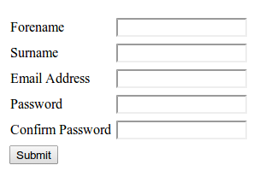
Currently: Getting user details
File called register.php
showRegister()
doRegister()
We need to incorporate a user type, i.e. who is registering, a tutor or a student?

Slide 20
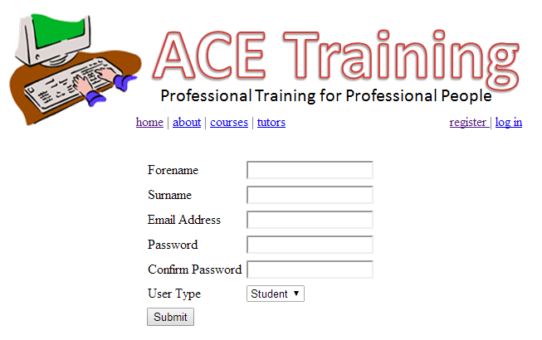
showRegister and doRegister
Same as last time
updated to include a dropdown list (tutor/student)
$sql = ("INSERT INTO user
(forename, surname,
email, password,
userType, authorised)
VALUES
('$fn', '$sn', '$ea', '$pw',
‘ut’,0 or 1 ?)
");
Problem here is that if the user registering is a tutor they should be set as not authorised, a student however should be set as authorised.

Slide 21
Solution
We check the type of user by using the value selected in the drop down list
We then select the appropriate SQL for that user
if ($ut == 'student')
{
$sql = ("INSERT INTO user (forename, surname, email, password, userType, authorised) VALUES ('$fn', '$sn', '$ea', '$pw', '$ut', 1)");
}
else
{
$sql = ("INSERT INTO user (forename, surname, email, password, userType, authorised)
VALUES ('$fn', '$sn', '$ea', '$pw', '$ut', 0)");
}

Slide 22
What we have done
Allowed a user to register
They choose if they are a student or a tutor
If they are a tutor
Added to the database as a tutor
Authorised set to 0 (false, no)
If they are a student
Added to the database as a student
Authorised set to 1 (true, yes)

Slide 23
Next: Logging In
When a user logs in their experience will differ depending on the type of user (userType).
Students can not add courses
If the user successfully logs in we need to check that the user is authorised to use the system.
Tutors can not add courses until authorised
We need to remember the user, and the type of user for the entire time ($_SESSION) that they use the system

Slide 24
Authentication
Currently once registered a user can login
We need to change this so that a user can’t login if they have not yet been authorised

Slide 25
Currently: doLogin()
$conn = mysqli_connect("localhost","root","root","aceTraining");
$ea = $_POST['email'];
$pw = $_POST['password'];
$sql = "SELECT * FROM user WHERE (email = '$ea' AND password = '$pw')";
$result = mysqli_query($conn, $sql) or die(mysqli_error($conn));
$record = mysqli_fetch_array($result);
if ($record['id'] == "")
{
echo ("login failed...");
}
else
{
echo ("login ok...");
$_SESSION['userId'] = $record['id'];
}

Slide 26
Updated: doLogin()
$_SESSION[‘userId’]
$_SESSION[‘userType’]
else
{
echo ("login ok...");
if ($record['authorised'] == 0)
{
echo (“account not yet authorised”);
}
else
{
$_SESSION['userId'] = $record['id'];
$_SESSION['userType'] = $record['userType'];
}
}

Slide 27
Users
The database currently has the following users for testing purposes:
babbage@ace.com Charles Babbage Tutor Authorised
turing@ace.com Alan Turing Tutor Authorised
flowers@ace.com Tommy Flowers Tutor Not yet authorised
neumann@ace.com John von Neumann Student Authorised (not enrolled on any courses)
engelbart@ace.com Douglas Engelbart Student Authorised (not enrolled on any courses)
jobs@ace.com Steve Jobs Student Authorised (not enrolled on any courses)
estridge@ace.com Phillip Don Estridge Student Authorised (not enrolled on any courses)
moore@ace.com Gordon Moore Student Not Authorised
gates@ace.com Bill Gates Student Authorised (not enrolled on any courses)
Bernes-lee@ace.com Tim Bernes-Lee Student Authorised (not enrolled on any courses)
default password is: mypass

Slide 28
Login Success!
$_SESSION[‘userId’]
$_SESSION[‘userType’]
When a user logs in you should direct them to a webpage based on the type of user they are

Slide 29
login.php
$_SESSION[‘userId’]
$_SESSION[‘userType’]
if (!isset($_POST['email']))
{
showLogin();
}
else
{
doLogin();
if ($_SESSION['userType'] == "tutor")
{
header('Location: tutors.php');
}
}

Slide 30

Currently: tutors.php
$_SESSION[‘userId’]
$_SESSION[‘userType’]
if (!isset($_SESSION['userId']))
{
echo ("You are not authorised to view this page!");
die();
}
else
{
echo ("hello - you are authorised to view this page");
}

Slide 31
Currently: tutors.php
Anybody logged in can access the tutors page
1. Change so only Tutors can view this page
2. Give them some options

Slide 32
Updated: tutors.php
$_SESSION[‘userId’]
$_SESSION[‘userType’]
if (!isset($_SESSION['userId']) OR $_SESSION['userType'] != 'tutor')
{
echo ("You are not authorised to view this page!");
die();
}
else
{
showMenu();
}

Slide 33

showMenu()
function showMenu()
{
echo ("
<a href='addCourse.php' class='btn'>Add a Course</a> <br /><br />
");
}

Slide 34
addCourse.php
We show the form to get course information, then we process the details from the form
Use our standard template as the structure is similar to what we have seen with:
showRegister(); to doRegister()
showLogin(); to doLogin()
We need to be a little careful, a student could find addCourse.php, so we also need to ensure that the user accessing this page is a tutor
We do this check several times so it makes sense to do this check as an include (later)

Slide 35
addCourse.php
Because of the similarity in structure with register.php
Open register.php
Save as addCourse.php

Slide 36
register.php saved as addCourse.php
<html><head><title>Register User</title>
<link rel="stylesheet" type="text/css" href="includes/myStyle.css"></head>
<body>
<?php
include("includes/head.php");
?>
<div id="content">
<?php
if (!isset($_POST['forename']))
{
showRegister();
}
else
{
doRegister();
}
?>
</div>
</body>
</html>
We change showRegister(); to showCourse(); and doRegister(); to doCourse(); o.e.
We also need to update the code in our functions, but this is nothing new, we still use the same techniques to get and do

Slide 37
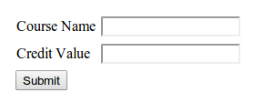
showCourse()
echo ("
<form id='form1' name='form1' method='post' action='addCourse.php'>
<table>
<tr>
<td>Course Name</td>
<td><input type='text' name='name' id='name' /></td>
</tr>
<tr>
<td>Credit Value</td>
<td><input type='text' name='creditValue' id='creditValue' /></td>
</tr>
</table>
<input type='submit' name='button' id='button' value='Submit' />
</form>
");

Slide 38

doCourse()
$_POST[‘name’]
$_POST[‘creditValue’]
$_SESSION[‘userId’]
$_SESSION[‘userType’]
$conn = mysqli_connect("localhost","root",“root","aceTraining");
$cn = $_POST['name'];
$cv = $_POST['creditValue'];
$ow = $_SESSION['userId'];
$sql = "INSERT INTO course (name, creditValue, owner)
VALUES ('$cn', '$cv', '$ow')";
$result = mysqli_query($conn, $sql) or die(mysqli_error($conn));
if ($result)
{
echo ("Course added successfully");
}
course
courseId (pk)
name
creditValue
owner (fk)

Slide 39
addCourse.php
We still need to restrict access to this page
And all other pages that should only be accessed by the tutor
Update course
Add resource
Update resource
Delete resource

Slide 40
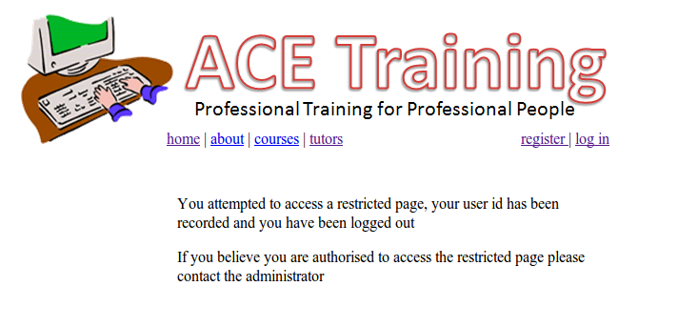
includes/checkTutor.php
$_SESSION[‘userId’]
$_SESSION[‘userType’]
if (!isset($_SESSION['userType']) or $_SESSION['userType'] != 'tutor')
{
header('Location: notAuthorised.php');
}

Slide 41
Tutor Pages
Every single tutor page can now perform a quick check to ensure the user is authorised to view/access that page
We include the check at the very start of the page (1st line).
If the user is not a tutor they will automatically be redirected to a notAuthorised.php page

Slide 42
Currently: tutors.php
$_SESSION[‘userId’]
$_SESSION[‘userType’]
<?php
if (!isset($_SESSION['userId']) OR $_SESSION['userType'] != 'tutor')
{
echo ("You are not authorised to view this page!");
die();
}
else
{
showMenu();
}
?>

Slide 43
Updated: tutors.php
<?php
include ("includes/checkTutor.php");
showMenu();
?>
If checkTutor.php fails, showMenu(); will never happen

Slide 44
So far
What we have done
Created a addCourse.php page
Ensure the user accessing this page is a tutor
Allowed the tutor to enter course details
Added the course details to the database
Next
Once student logs in redirect to their page
Allow students to enrol on a course
Allow tutors to authorise students
Allow tutors to enter student details directly
Allow tutors to enrol student from file

Slide 45
Redirect a User
We done this already for tutor
if (!isset($_POST['email']))
{
showLogin();
}
else
{
doLogin();
if ($_SESSION['userType'] == "tutor")
{
header('Location: tutors.php');
}
}

Slide 46
Redirect a User
We done this already for tutor
if (!isset($_POST['email']))
{
showLogin();
}
else
{
doLogin();
if ($_SESSION['userType'] == "tutor")
{
header('Location: tutors.php');
}
if ($_SESSION['userType'] == “student")
{
header('Location: students.php');
}
}

Slide 47

students.php
Calls a function called showMenu();
function showMenu()
{
echo ("
<a href='selectCourse.php' class='btn'>Course Enrol</a> <br /><br />
");
}

Slide 48
selectCourse.php
Show a list of available courses and allow the student to select one or more courses to enrol on
showCourses();
Process the enrolement
doEnrolement();

Slide 49
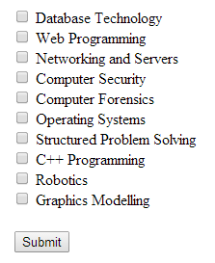
showCourses()
Get courses from database
Create a form
Create check box with course id and display name of course
Keep doing 3 until no more courses
course
courseId (pk)
name
creditValue
owner (fk)

Slide 50
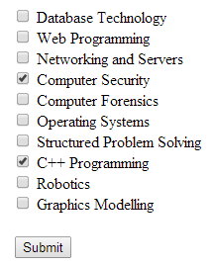
doEnrolement()
Put the checked course(s) into the table studentTaking, set authorised to false (tutors job to authorise the students for their course).
$_SESSION[‘userId’]
studentTaking
id (fk)
courseId (fk)
dateEnrolled
authorised
date(“Y-m-d”);
0

Slide 51

showCourses()
$conn = mysqli_connect("localhost","root","root","aceTraining");
$sql = "SELECT * from course";
$result = mysqli_query($conn,$sql);
echo ("<form id='form1' name='form1' method='post' action='selectCourse.php'>");
while ($record = mysqli_fetch_array($result))
{
echo ("<input type='checkbox' name='courseID[]'
value='$record[courseId]'> $record[name] <br />");
}
echo ("<br /><input type='submit' name='button' id='button' value='Submit' /></form>");
name='courseID[]'
courseID[0]=4
courseID[1]=8
value='$record[courseId]'

Slide 52
doEnrolement()
$_POST[‘courseID[0]=4’]
$_POST[‘courseID[1]=8’]
$conn = mysqli_connect("localhost","root", "root","aceTraining");
$dateEnroled = date("Y-m-d");
$userId = $_SESSION['userId'];
foreach ($_POST['courseID'] as $courseId)
{
$sql = "INSERT INTO studentTaking (id, courseId, dateEnrolled, authorised) VALUES
('$userId','$courseId','$dateEnroled',0)";
$result = mysqli_query($conn,$sql) or die(mysqli_error($conn));
if ($result)
{
echo ("Successfully registered for course id " . $courseId . "<br />");
}
}
$dateEnroled
$userId
$courseId
studentTaking
id (fk)
courseId (fk)
dateEnrolled
authorised

Slide 53
Students waiting to be authorised
Tutors should authorise students enroled for their course(s)
Tutors should not authorise students not taking their course
Begins to get a little tricky as we are dealing with multiple tables at the same time!
Show the tutor logged in students waiting to be authorised on their courses (use check boxes like before).
Do authorise

Slide 54
Show the tutor
1. Select all the course id's that belong to the tutor that is logged in (course table)
2. Select all the student id's enrolled for those courses that are waiting to be authorised (studentTaking table)
3. Show the student details based on their id's (user table)
aceTraining
user
id (pk)
forename
surname
email
Password
userType
authorised
course
courseId (pk)
name
creditValue
owner (fk)
studentTaking
id (fk)
courseId (fk)
dateEnrolled
authorised

Slide 55
Courses that belong to tutor
$_SESSION[‘userId’]
$_SESSION[‘userType’]
$conn = mysqli_connect("localhost","root","root","aceTraining");
$sql = "SELECT * FROM course WHERE owner = $_SESSION[userId]";
$result = mysqli_query($conn,$sql);
$options = "<option>Select a Course</option>";
$result
course
courseId (pk)
name
creditValue
owner (fk)
courseId | name | creditValue | owner
1 | Database Technology | 30 | 2
2 | Web Programming | 30 | 2
3 | Networks and Servers | 15 | 2
4 | Computer Security | 30 | 2
5 | Computer Forensics | 30 | 2
$options
<option> Select a Course </option>

Slide 56
Courses that belong to tutor
$conn = mysqli_connect("localhost","root","root","aceTraining");
$sql = "SELECT * FROM course WHERE owner = $_SESSION[userId]";
$result = mysqli_query($conn,$sql);
$options = "<option>Select a Course</option>";
while ($record = mysqli_fetch_array($result))
{
$options .= "<option value='$record[courseId]' > $record[name] </option> ";
}
echo ("Please select the course you wish to enrol student on");
echo ("<form name='form1' method='post' action='enrolStudent.php' >
<select name='course' onchange='submit()' >");
echo ($options);
echo ("</select></form>");
$record
courseId | name | creditValue | owner
1 | Database Technology | 30 | 2
$options
<option> Select a Course </option>
<option value=‘1’> Database Technology </option>
$result
courseId | name | creditValue | owner
1 | Database Technology | 30 | 2
2 | Web Programming | 30 | 2
3 | Networks and Servers | 15 | 2
4 | Computer Security | 30 | 2
5 | Computer Forensics | 30 | 2

Slide 57
Courses that belong to tutor
$conn = mysqli_connect("localhost","root","root","aceTraining");
$sql = "SELECT * FROM course WHERE owner = $_SESSION[userId]";
$result = mysqli_query($conn,$sql);
$options = "<option>Select a Course</option>";
while ($record = mysqli_fetch_array($result))
{
$options .= "<option value='$record[courseId]' > $record[name] </option> ";
}
echo ("Please select the course you wish to enrol student on");
echo ("<form name='form1' method='post' action='enrolStudent.php' >
<select name='course' onchange='submit()' >");
echo ($options);
echo ("</select></form>");
$record
courseId | name | creditValue | owner
2 | Web Programming | 30 | 2
$options
<option> Select a Course </option>
<option value=‘1’> Database Technology </option>
<option value=‘2’> Web Programming </option>
$result
courseId | name | creditValue | owner
1 | Database Technology | 30 | 2
2 | Web Programming | 30 | 2
3 | Networks and Servers | 15 | 2
4 | Computer Security | 30 | 2
5 | Computer Forensics | 30 | 2

Slide 58
The process continues until
$options
<option> Select a Course </option>
<option value=‘1’> Database Technology </option>
<option value=‘2’> Web Programming </option>
<option value=‘3’> Networking and Servers </option>
<option value=‘4’> Computer Security </option>
<option value=‘5’> Computer Forensics </option>

Slide 59
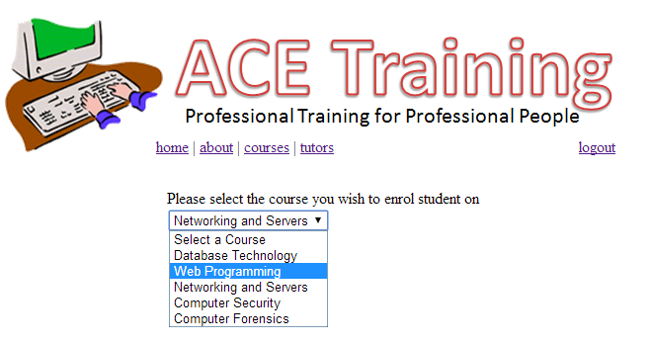
Courses that belong to tutor
$options
$conn = mysqli_connect("localhost","root","root","aceTraining");
$sql = "SELECT * FROM course WHERE owner = $_SESSION[userId]";
$result = mysqli_query($conn,$sql);
$options = "<option>Select a Course</option>";
while ($record = mysqli_fetch_array($result))
{
$options .= "<option value='$record[courseId]' > $record[name] </option> ";
}
echo ("Please select the course you wish to enrol student on");
echo ("<form name='form1' method='post' action='enrolStudent.php' >
<select name='course' onchange='submit()' >");
echo ($options);
echo ("</select></form>");
<option> Select a Course </option>
<option value=‘1’> Database Technology </option>
<option value=‘2’> Web Programming </option>
<option value=‘3’> Networking and Servers </option>
<option value=‘4’> Computer Security </option>
<option value=‘5’> Computer Forensics </option>

Slide 60
Next: Process Selection
The user selects an option from the list
<select name='course' onchange='submit()' >");
As soon as this select changes the information is submitted to be dealt with
Remember each option has its own value
<option> Select a Course </option>
<option value=‘1’> Database Technology </option>
<option value=‘2’> Web Programming </option>
<option value=‘3’> Networking and Servers </option>
<option value=‘4’> Computer Security </option>
<option value=‘5’> Computer Forensics </option>
$_POST[‘course’]

Slide 61
showStudents.php
$_POST[‘course’]=2
$_SESSION[‘userId’]
$_SESSION[‘userType’]
$conn = mysqli_connect("localhost","root","root","aceTraining");
$cId = $_POST['course'];
$tId = $_SESSION['userId'];
$sql = "SELECT * FROM studentTaking WHERE courseId = $cId AND authorised = 0";
$result = mysqli_query($conn,$sql) or die(mysqli_error($conn));
$students = "";
$students
$result
studentTaking
id (fk)
courseId (fk)
dateEnrolled
authorised
id | courseId | dateEnrolled | authorised
2 | 2 | 2013-02-16 | 0
3 | 2 | 2013-02-17 | 0
9 | 2 | 2013-02-17 | 0

Slide 62
showStudents.php
user
id (pk)
forename
surname
email
Password
userType
authorised
while ($record = mysqli_fetch_array($result))
{
$sql2 = "SELECT * FROM user WHERE id = $record[id]";
$result2 = mysqli_query($conn,$sql2);
$record2 = mysqli_fetch_array($result2);
$result
$result2
id | courseId | dateEnrolled | Authorised
2 | 2 | 2013-02-16 | 0
3 | 2 | 2013-02-17 | 0
9 | 2 | 2013-02-17 | 0
id | forename | surname | email …
2 | Simon | Jones | joness@
$record
$record2
id | courseId | dateEnrolled | authorised
2 | 2 | 2013-02-16 | 0
id | forename | surname | email …
2 | Simon | jones | joness@

Slide 63
showStudents.php
$record2
id | forename | surname | email …
2 | Simon | jones | joness@
if ($record2['id'] != "")
{
$students .= "<input type='checkbox' name='id[]' value='$record2[id]' > " .
$record2['surname'] . " " . $record2['forename'] . "<br />";
}
} //end of the while
$result
$students
<input type=‘checkbox’ name=‘id[]’ value=‘2’ > Simon Jones

Slide 64
showStudents.php
user
id (pk)
forename
surname
email
Password
userType
authorised
while ($record = mysqli_fetch_array($result))
{
$sql2 = "SELECT * FROM user WHERE id = $record[id]";
$result2 = mysqli_query($conn,$sql2);
$record2 = mysqli_fetch_array($result2);
$result
$result2
id | courseId | dateEnrolled | Authorised
2 | 2 | 2013-02-16 | 0
3 | 2 | 2013-02-17 | 0
9 | 2 | 2013-02-17 | 0
id | forename | surname | email …
3 | Peter | Pan | panp@
$record
$record2
id | courseId | dateEnrolled | authorised
2 | 2 | 2013-02-16 | 0
id | forename | surname | email …
3 | Peter | Pan | panp@

Slide 65
showStudents.php
$record2
id | forename | surname | email …
3 | Peter | Pan | panp@
if ($record2['id'] != "")
{
$students .= "<input type='checkbox' name='id[]' value='$record2[id]' > " .
$record2['surname'] . " " . $record2['forename'] . "<br />";
}
} //end of the while
$result
$students
<input type=‘checkbox’ name=‘id[]’ value=‘2’ > Simon Jones
<input type=‘checkbox’ name=‘id[]’ value=‘3’ > Peter Pan

Slide 66
Process Continues
While there are students to process
The while terminates and the program continues with the following script
Allowing the tutor to select the checkboxes
Notice we retain the course id by using a hidden text box
echo ("Select the students that you wish to authorise.");
echo ("<form name='form1' method='post' action='enrolStudent.php' >");
echo ($students);
echo ("<input type='hidden' name='courseId' value='$cId' /");
echo ("<br /><input type='submit' onclick='submit' value='Enrol' /></form> ");

Slide 67
enrolStudents.php
foreach ($_POST['id'] as $id)
{
$cId = $_POST['courseId'];
echo ("Enroled user: " . $id . " for course Id: " . $cId . "<br />");
$sql = "UPDATE studentTaking SET authorised = 1 WHERE id = '$id'
AND courseId = $cId ";
mysqli_query($conn,$sql) or die(mysqli_error($conn));
}
$result

Slide 68
Summary
Created different users
Created courses
Enroled students
Authorised students

Slide 69
Any Questions?

